Slide 1
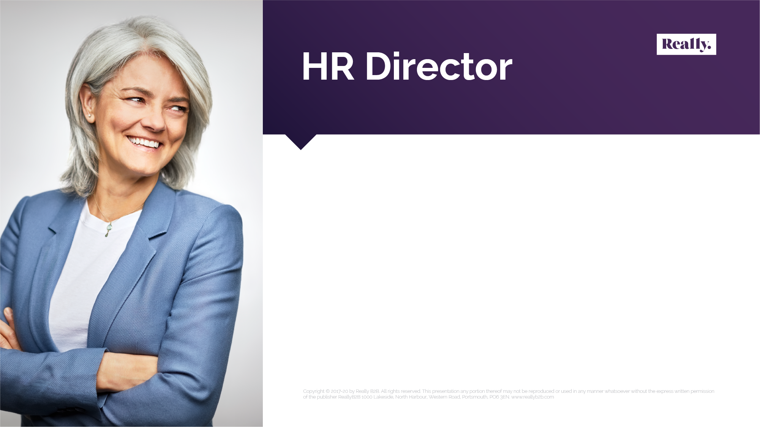
While the initial wave of Covid-19 has passed, the impact it had on the workplace will last forever – and this means HR personnel are now facing new and long-lasting challenges. From the hurdles brought on by remote and disparate working, to the technology needed to keep employees connected, HR directors must upskill and adapt like never before. But one challenge that the “new normal” has prompted more than any other is employee health. Whether that be physical health relating to the virus or mental health relating to remote working and loneliness – HR decision-makers must now pay closer attention than ever to workers’ health needs and provide a wider network of support than ever before.
Human resource decision-makers are typically I personalities.
I personality motivations:
Popularity
Feelings and emotions
Fun and interactive experiences
Recognition
Improving the atmosphere
Visibility
Notes:
Kristina

